Slide 1
Reinforcement Learning

Slide 2
Examples

Slide 3
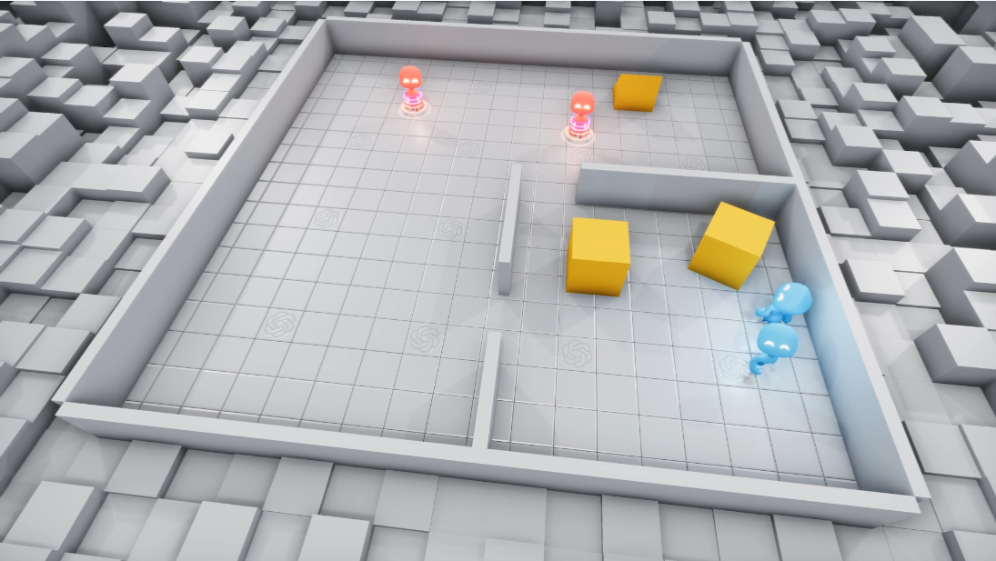
OpenAI Hide and Seek
https://openai.com/blog/emergent-tool-use/

Slide 4
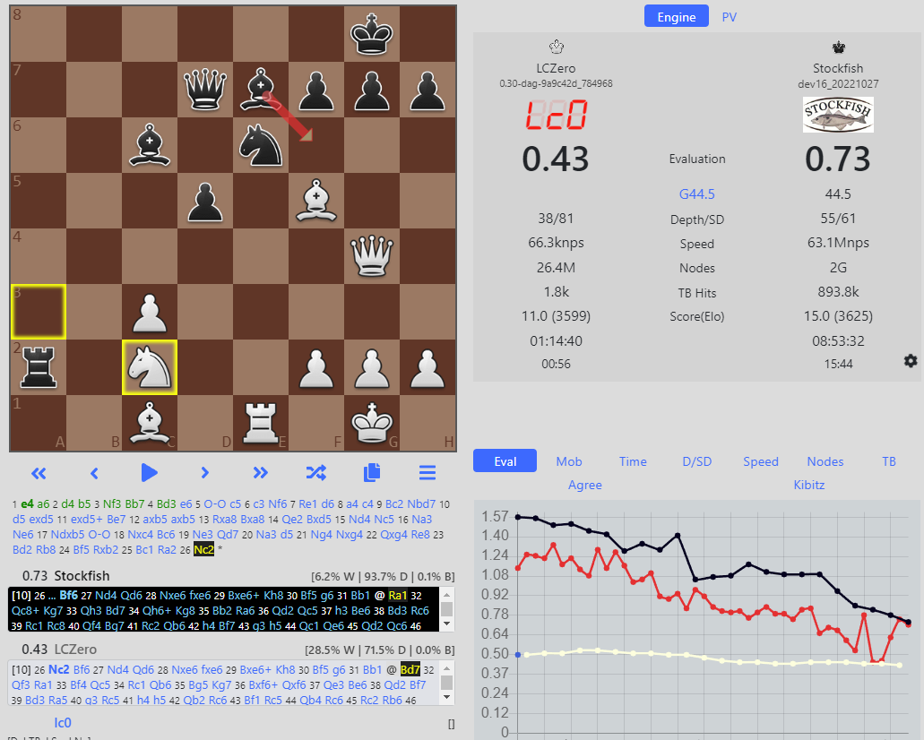
Leela Chess Zero (Lc0)
https://lczero.org/

Slide 5
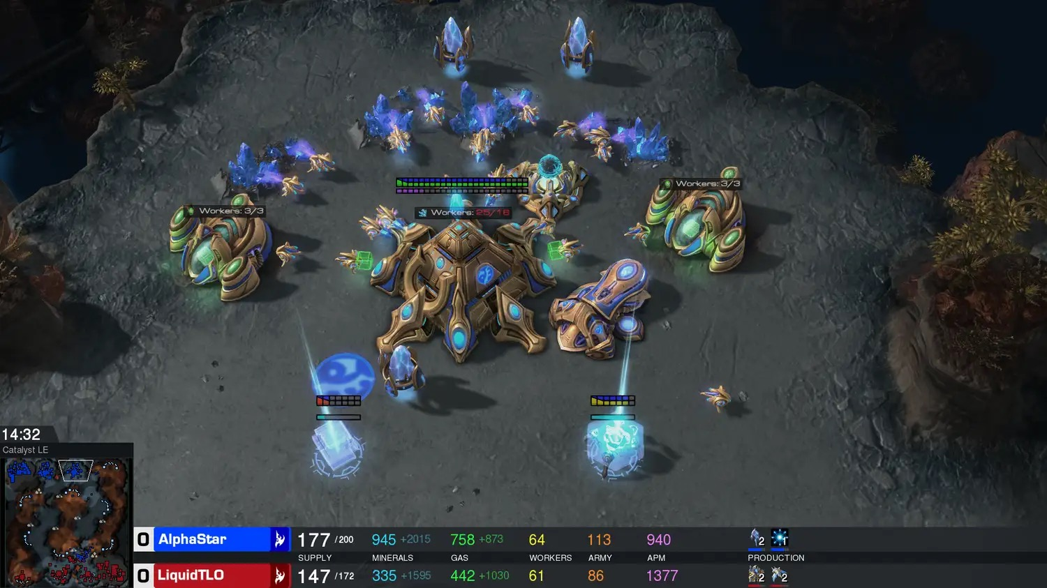
Alpha Star
https://www.deepmind.com/blog/alphastar-mastering-the-real-time-strategy-game-starcraft-ii

Slide 6
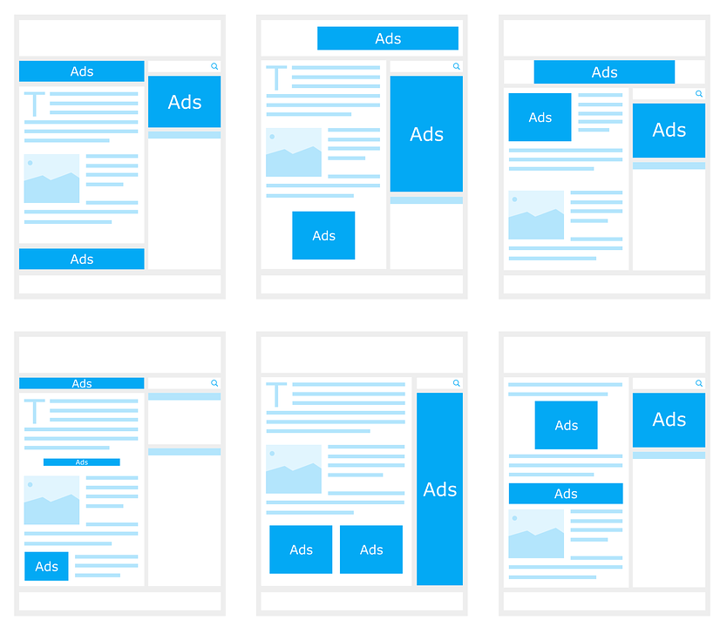
Custom Advertisement

Slide 7
RL Basics

Slide 8
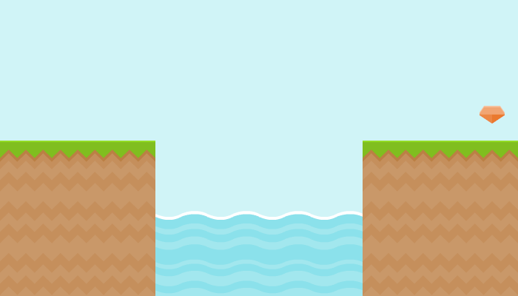

What we have
Environment
Agent

Slide 9

What we have
Air/Ground: 0
Reward
Action
Gem: +1
Water: -1

Slide 10
What we have
State
X: 3.5
Y: 5.6
Alive: yes
Gems collected:
0 of 1

Slide 11
Example - TicTacToe

Slide 12
Example - TicTacToe
Agent

Slide 13
Example - TicTacToe
Agent
Players (X, O)

Slide 14
Example - TicTacToe
Agent
Players (X, O)
State

Slide 15
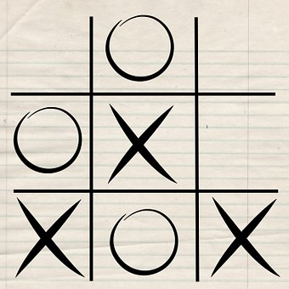
Example - TicTacToe
Agent
Players (X, O)
State

Slide 16
Example - TicTacToe
Agent
Players (X, O)
State
Actions

Slide 17
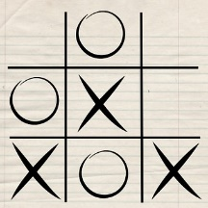
Example - TicTacToe
Agent
Players (X, O)
State
Actions

Slide 18
Example - TicTacToe
Agent
Players (X, O)
State
Actions
Rewards

Slide 19
Example - TicTacToe
Agent
Players (X, O)
State
Actions
Rewards
Won: +1
Lost: -1
Else: 0

Slide 20
Further Examples
What are agents, state, actions and possible rewards in...
...Leela Chess Zero
...OpenAI Hide and Seek
...Custom Advertisement

Slide 21
Q-Learning

Slide 22
Reinforcement Learning Loop
Agent
Environment

Slide 23
Reinforcement Learning Loop
chooses
Action
Agent
Environment

Slide 24
Reinforcement Learning Loop
chooses
Action
Agent
Environment
receives
New State & Reward

Slide 25
Q-Learning
For each state we store a quality value (Q-value) for each action (how good the action is given the state)

Slide 26
Q-Learning
For each state we store a quality value (Q-value) for each action (how good the action is given the state)
Then, whenever a state is reached, choose the action with the highest Q-value

Slide 27
Q-Learning
For each state we store a quality value (Q-value) for each action (how good the action is given the state)
Then, whenever a state is reached, choose the action with the highest Q-value
Finally increase/decrease the Q-value in regards to the reward after the action was performed

Slide 28
Q-Learning
For each state we store a quality value (Q-value) for each action (how good the action is given the state)
Then, whenever a state is reached, choose the action with the highest Q-value
Finally increase/decrease the Q-value in regards to the reward after the action was performed
For small scenarios, this can be stored in a table (Q-table)

Slide 29
Q-Table example
State | Step left | Step right | Jump left | Jump right
 | 0 | 1 | -1 | 0
 | -1 | 0 | -1 | 1
...

Slide 30
Q-Table example
State | Step left | Step right | Jump left | Jump right
 | -0.2 | 1 | -1 | 0
 | -1 | 0.5 | -1 | 1
...

Slide 31
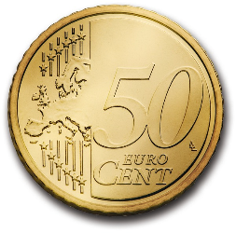
Coin Game
Try it on a real example!

